Slide 1

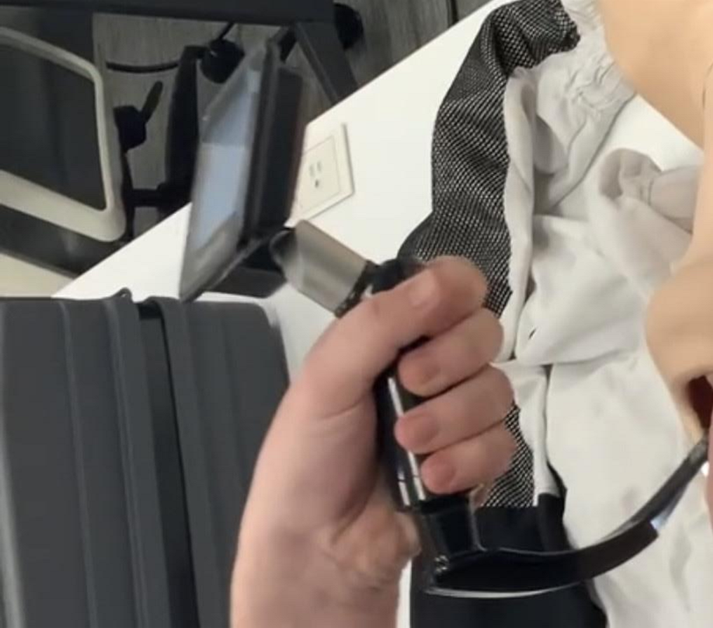
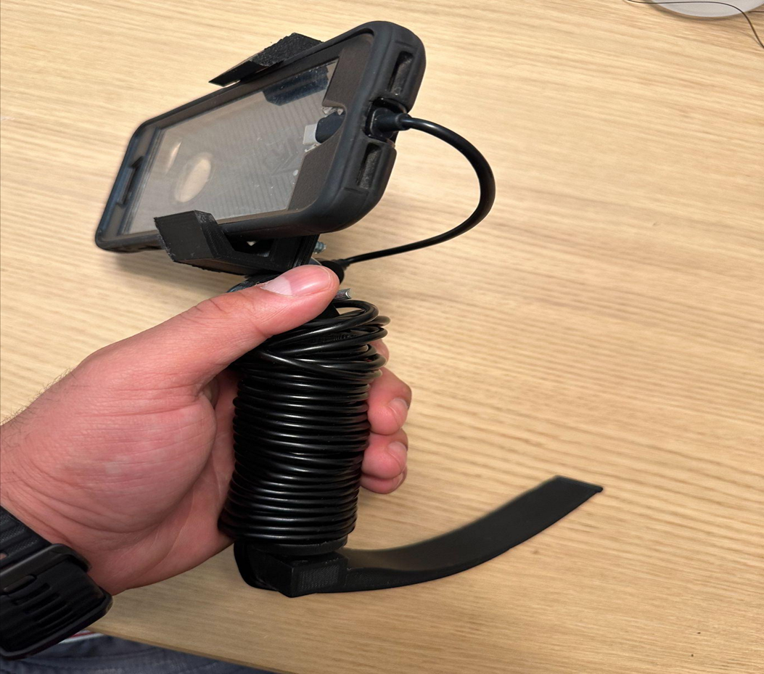

Comparison of 3D-printed Video Laryngoscopes to Commercial Laryngoscopes for Training Simulation
Tran, Sthefon¹; Ferrell, Stuart¹; Chen, Andreana¹; Chandramohan, Dharshan¹; Jackson, Sean²; Sahai, Shubhika³, Dr. Madhu Varma¹ ¹California University of Science and Medicine, ²Carnegie Mellon University, ³University of California Santa Barbara
PROBLEM STATEMENT
METHODS
RESULTS
To evaluate the efficacy of 3D printed (3DP) video laryngoscopes as a training tool compared to commercial video laryngoscopes for resource limited areas.
3DP has become widely available and cheap, medical equipment can be printed for medical education in resource-limited settings,
Kenya, a low healthcare resource country, is embracing 3DP and localization of 3DP allows for production of costly items like commercial laryngoscopes
Academic studies on the use of 3DP in developing countries are few.
Simulations in healthcare training such as intubation can incorporate 3DP as a viable, cheap, and dispensable resource for these communities.
TRAINING BLOCK 1 (10 MIN)
 | 3D Printed Laryngoscope | GlideScope | P value
Ratio of Success vs Failures (N=807) | 0.96 ± 0.19 | 0.92 ± 0.276 | 0.007
Average Duration Time (sec) (N=807) | 35.41 ± 16.781 | 32.939 ± 16.69 | 0.002
Ratio of Teeth Breaks (N=817) | 0.07 ± 0.273 | 0.13 ± 0.461 | 0.052
RATIONALE
 | Gender |  | P value
 | Female | Male
Ratio of Success vs Failures (N=807) | 0.93 ± 0.26 | 0.95 ± 0.221 | 0.211
Average Duration Time (sec) (N=807) | 35.39 ± 17.431 | 32.805 ± 16.01 | 0.003
Ratio of Teeth Breaks (N=817) | 0.16 ± 0.503 | 0.04 ± 0.199 | <0.001
GlideScope GO Laryngoscope (32 Medical Students)
TRAINING BLOCK 2 (10 MIN)
POTENTIAL IMPACT
The 3D printed Laryngoscope will provide a comparable training tool as a commercial laryngoscope. 3D printers can be a tool that can assist remote hospitals or providers get access to training devices that they would not be able to if they tried to purchase each individual tool commercially.
RESEARCH QUESTIONS
How effective are 3DP video laryngoscopes to commercial laryngoscopes?
Are there significant differences in performance using laryngoscopes between females and males?
3DP Video Laryngoscope
(16 Medical Students)
GlideScope GO Laryngoscope
(16 Medical Students)
SURVEY
ACKNOWLEDGEMENTS
The authors of this study would like to graciously thank Dr. Carol Lee & the Emergency Department at ARMC for use of the GlideScope GO device used in this study.
1. Karippacheril JG, Le Cong M. Videolaryngoscopy using an Android smartphone: A direct digital technique. Indian J Anaesth. 2016;60(2):143-145. doi:10.4103/0019-5049.176288
2. Ali Kaan Ataman, Emel Altıntas, Comparison of a commercial 3D fabricated laryngoscope (Airangel ®) with a widely-used video laryngoscope (Glidescope®): Randomized controlled cross-over study, Trends in Anaesthesia and Critical Care, Volume 40, 2021, Pages 35-40, ISSN 2210-8440, https://doi.org/10.1016/j.tacc.2021.05.009.
3. "Survey" icon by Larea from Noun Project
Demographic questions, questions evaluating hand eye coordination and prior intubation experience, and questions comparing the two devices.
REFERENCES
STATISTICAL ANALYSIS
SPSS Statistics version 28 (IBM, Armonk, NY) was used for statistical analysis with p-values for significance set to 0.05.
Mann-Whitney U test and Chi-square test were used when appropriate.

